Slide 1
2024 Annual POA Meeting
February 20, 2024
PRESENTED BY:
YOUR POA BOARD OF DIRECTORS
www.thepointatlkn.com

Slide 2
www.thepointatlkn.com
Agenda
Welcome & Introductions
3
President’s Report
4
Election of New Board Members
9
Treasurer’s Report
14
Committee Reports
21
CCR Amendment to Allow Irrigation Wells
44
46
Questions & Closing Remarks
© The Point Owners Association, Inc., 2024
2

Slide 3
www.thepointatlkn.com
POA Leadership
POA BOARD MEMBERS
Ken Foster President
Terry Ravas, Vice President
Paul Dascoli, Treasurer
Linda Bundens, Secretary
Rod Baldwin, Member at Large
Bob Lorch, Member at Large
Joe Petrozza, Member At Large
.
HAWTHORNE MANAGEMENT
Kristi Alexander, Community Manager
Ashleigh Jones, Administrative Assistant
Please Hold Your Questions Until The End
Thank you!
© The Point Owners Association, Inc., 2024
3

Slide 4
www.thepointatlkn.com
President’s Report
© The Point Owners Association, Inc., 2024
4

Slide 5
www.thepointatlkn.com
Three Parts of our Community
Shaw Tate
(The Declarant)
Point Owners Association (POA) Board
Trump National Golf Club (TNGC)
New Lot Sales
Adherence to CCRs
(Conditions, Covenants & Restrictions)
TNGC Tennis
Establish and Collect Assessments
TNGC Pool
New Home Building
Maintain Community (Including Common Space and the Village Green)
TNGC Golf Course
Existing Home AChC
(Architectural Change Committee)
TNGC Ball Room
867 Lots → 17 Remain Undeveloped
© The Point Owners Association, Inc., 2024
5

Slide 6
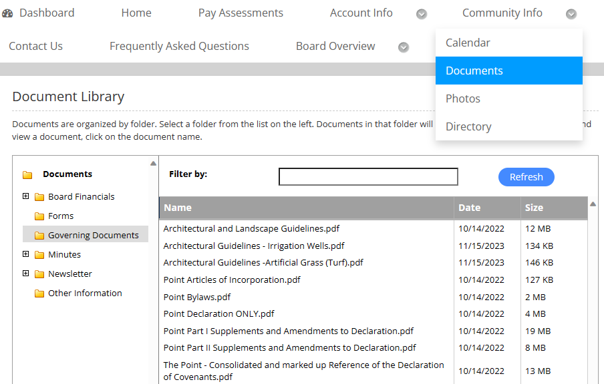
www.thepointatlkn.com
The CCR’s (Covenants, Conditions & Restrictions)
The Board of Directors are required by NC law to apply the CCRs as they are written, and ensure the CCRs are administered in a fair and equitable basis.
Community Website
Hawthorne Management Website
© The Point Owners Association, Inc., 2024

Slide 7
www.thepointatlkn.com
POA Sponsored Committees
COMMITTEE CHAIRMAN/ COMMITTEE LEAD(S)
Architectural Ken Foster
Communications Terry Ravas, Lori Smith-Patrick,
Shauna Yardley
Club Covenants Rod Baldwin
Finance Paul Dascoli
Infrastructure Tom Uhl
Landscape Nancy Bigelow
Berm Refresh Joe Petrozza
Nominating Charlie Farrar
Safety and Security Rod Baldwin
Pier Association Joe Klaja
7
© The Point Owners Association, Inc., 2024

Slide 8
www.thepointatlkn.com
POA Volunteers
Our 70+ volunteers make The Point the exceptional community it is today. We are grateful for your time and dedication throughout the year and offer a heartfelt THANK YOU for all that You do!
© The Point Owners Association, Inc., 2024
8

Slide 9
www.thepointatlkn.com
Board Member Election
© The Point Owners Association, Inc., 2024
9

Slide 10
www.thepointatlkn.com
Nominating Committee
Appointed by the Board annually
Operates independently and is responsible for identifying and screening potential Board candidates
The Board provides input if there are specific skills needed
Nominating Committee Members | 2023 | 2024
Roger Schwartz (Outgoing Chair) | X
Regina Watts | X | X
Charlie Farrar (Incoming Chair) | X | X
Donette Dewar-Black | X | X
Bob Lorch |  | x
© The Point Owners Association, Inc., 2024
10

Slide 11
www.thepointatlkn.com
Election of Board Candidates
Election Parameters
Per our Bylaws, three-year Board terms are “staggered” to allow for continuity as well as change
Two Board seats are up for election in 2024
Pre-Annual Meeting Process
Solicit Candidates
The Stroll– announcement of election in November issue
POA Newsletters
Candidates interviewed; slate finalized
Candidate biographies and proxy mailed in Annual Meeting notice; information also provided via POA Newsletter
Members return proxy via E-mail (preferred) or US Mail to Hawthorne Management
11
© The Point Owners Association, Inc., 2024

Slide 12
www.thepointatlkn.com
Election of Board Candidates
Annual Meeting Process
Slate of candidates presented
Nominations taken from the floor (Nominees must be members in good standing)
Votes are counted and new board members announced via email
12
© The Point Owners Association, Inc., 2024

Slide 13
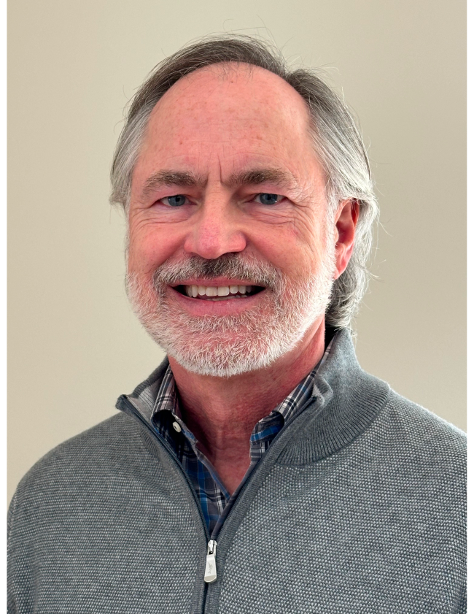
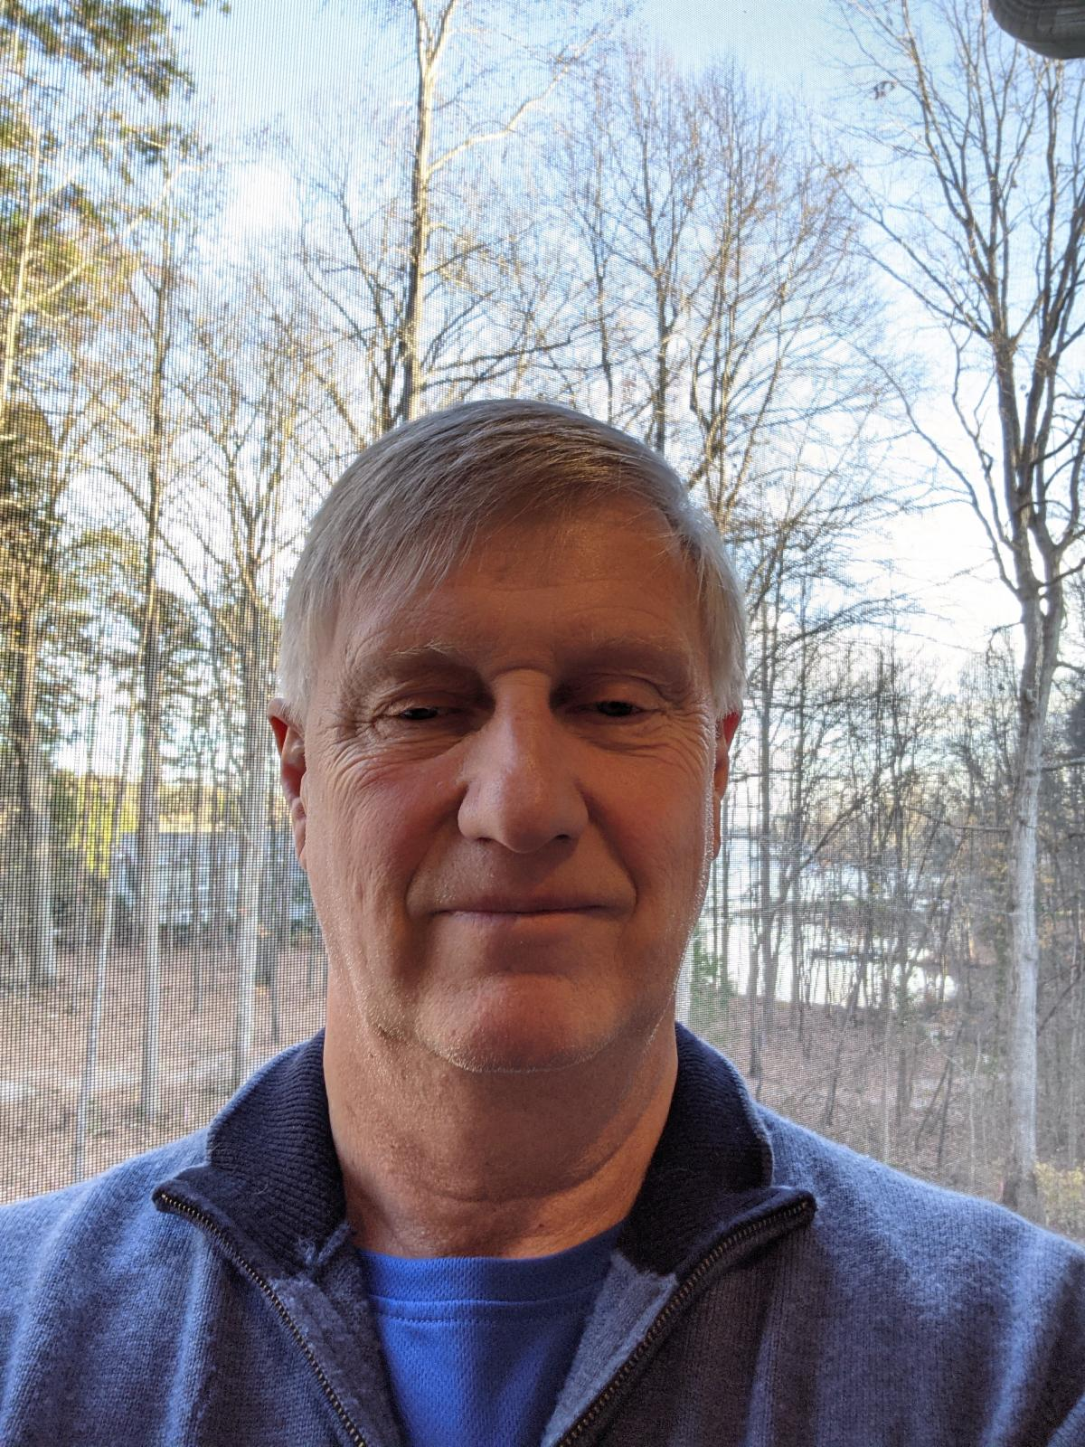
www.thepointatlkn.com
2024 Board Candidates
Stephen Taylor
Ken Foster
13
© The Point Owners Association, Inc., 2024

Slide 14
www.thepointatlkn.com
Treasurer’s Report
14
© The Point Owners Association, Inc., 2024

Slide 15
www.thepointatlkn.com
Financial Results December 31, 2023
 | Actual | Budget | Variance
Gross Income * | $2,235,253 | $2,209,227 | $26,026
Operating Expense * | $2,262,590 | $2,208,549 | $54,041
Net Operating Results | $27,337 | $678 | $28,015
Contribution to Reserves | $325,569 | $287,050 | $38,519
POA Positive Operating Variance Contributed to Reserves | $0 | $678 | $(678)
Net Income/Loss | $27,337 | $678 | $28,015
Gross Income Positive Variances:
Zero Budget Items:
Interest $27,381
ARC Fees $3,250
Late Fees $8,402
Fines $4,225
* Adjusted for Pier Special Assessments, inclusive of reserve funding
Note: Sconset surplus of $2,837 moved to reserves in January 2024.
© The Point Owners Association, Inc., 2024
15

Slide 16
www.thepointatlkn.com
Operating Expense Material Variances
Category: | Variance | Comments
Tree Removal/Replace Signs Boat Slip Lease Payment Insurance Expense Claim Electricity - Lights TOTAL | ($33,285) ($6,677) ($12,450) ($21,537) ($15,838) ($89,787) | Continued Aging and Storm Damage Unanticipated Repairs Annual Lease Increase Exceeded Projection To be reimbursed Higher usage and rates
Pine Needles Landscape Cleanup Landscape - Projects Village Green Maintenance Sidewalks Bridges on trails Electricity Property Taxes Sip-N-Shop Legal Costs of Collections Storm Water Maintenance Insurance Expense TOTAL | $23,250 $8,800 $5,471 $3,500 $7,257 $4,515 $4,365 $5,332 $10,717 $5,267 $2,770 $3,428 $84,672 | Better rates on purchase Used to offset tree replacement/removal Lower identification of needs Lower identification of needs Annual Increase Less than Projections Net Income to POA Fewer Liens and Foreclosures Occurred Negotiated rate improvement
16

Slide 17
www.thepointatlkn.com
2023 Reserves Accounts
 | General | Irrigation | Infrastructure | Private Drives | Sconset | Landscape Reserve
Beginning Balance | $104,618 | $0 | $225,810 | $176,353 | $221,710 | $0
Planned Contribution | $0 | $21,000 | $35,000 | $26,550 | $9,500 | $195,000
Uses | ($37,828) |  | ($27,679) | $0 | ($935) | $131,137
Additional Contribution | $29,458 |  |  | $3,524 | $7,366
Ending | $96,248 | $21,000 | $233,131 | $206,427 | $237,641 | $63,863
17
© The Point Owners Association, Inc., 2024

Slide 18
www.thepointatlkn.com
2024 Budget
Operating Income Operating Expense | $2,554,892 $2,543,139 | 3% assessment increase. Inclusive of reserve funding.
Planned Reserve Contribution | $243,050 | Decrease in infrastructure and irrigation reserves based upon projected reserve balances and need
Pass-Through Assessments | ($775,667) | Obligated to Offset Third Party Costs (Septic, Sconset, Pier Association, Property Tax and Boat Slip Lease)
Specified Reserve Assessments | ($27,550) | Private Drives
Income from Other Sources | ($69,695) | TNGC Cost Contribution, ATC Cable Rent and Storage Lot Rent
General Assessment Need: | $1,681,980 | Allocated among 867 Lots = $1,940 General Assessment $55 Increase from 2023
18
© The Point Owners Association, Inc., 2024

Slide 19
www.thepointatlkn.com
2024 Assessment
Material Cost Drivers | Amount of Increase
Landscaping costs (general maint., pine needles, tree removal/replacement | $68.3K
Infrastructure costs (sidewalks, general upkeep, bridges on trails, fence repairs) | $22,000
Administrative expenses (Management company fee, zero budgeted sip & shop income, legal expense) | $23,000
Reduction in infrastructure reserve funding (based upon account balance and projected needs) | ($20,000)
Reduction in Irrigation reserve funding (based upon account balance and projected needs) | ($15,000)
Slight reduction in Berm Refresh Project (3 Years) | ($10,000)
~$129,000
Overall
Op Ex Increase
Total Reserve Funding
$243,000
Increase is offset, in part, by other cost cuts across numerous expense and reserve accounts
© The Point Owners Association, Inc., 2024

Slide 20
www.thepointatlkn.com
2024 Projected Reserve Account Activity
 | General | Irrigation | Infrastructure | Landscape | Private Drives | Sconset
Beginning Balance | $96,248 | $21,000 | $233,131 | $63,863 | $207,427 | $237,641
Transfers | $0 | $0 |  | $0 | $0 | $0
Planned Contribution | $0 | $6,000 | $15,000 | $185,000 | $27,550 | $9,500
Planned Uses | $0 | $0 | ($45,000)* | ($248,863) | $0 | ($9,500)
Projected End Balances | $96,248 | $27,000 | $203,131 | $0 | $234,977 | $237,641
*Planned Uses in 2024
$3,000 Sidewalk Replacements/Drains
$25,000 Trails
$10,000 Storm water drains
$249K for berm refresh project
20
© The Point Owners Association, Inc., 2024

Slide 21
www.thepointatlkn.com
Committee Reports
Volunteers in Action!
21
© The Point Owners Association, Inc., 2024

Slide 22
www.thepointatlkn.com
Landscape Committee
Members
Nancy Bigelow (chair)
Anthony Johnson
Cathy Grossu
Cindy Fitzharris
Stephen Taylor
Garry Murphee
Joe Petrozza
Contractors​
Bland Landscaping​ (thru 1/31/24)
Cortes Landscaping (begin 2/1/24)
Box of Rain​
Arborguard​
Carolina Land Consultants​
Brad Vice
David McDonnell​
Board Liason
Linda Bundens
22
© The Point Owners Association, Inc., 2024

Slide 23
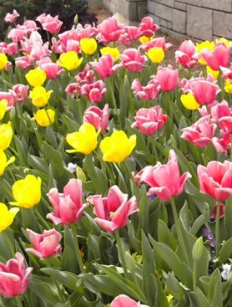
www.thepointatlkn.com
Landscape Committee
2023 Accomplishments​
The committee and BOD continue to evaluate the work and pricing of landscape contractors. The change from Bland to Cortes reflects these efforts to improve service and lock in pricing for 3 years.
Worked closely with flower bed designer to develop a more contemporary design
Developed and implemented a intensive program to address disease and insect damage
Identification/removal and replacement of dead or damaged maple trees along BSR
Published educational articles in The Stroll magazine
2023 Challenges​
Irrigation cost increase due to damage caused by contractors installing wires/cables. Aggressive collection efforts underway to obtain reimbursement for repairs
Continued repair of property damage to plants, grass and landscaping lighting due to vandalism
23
© The Point Owners Association, Inc., 2024

Slide 24
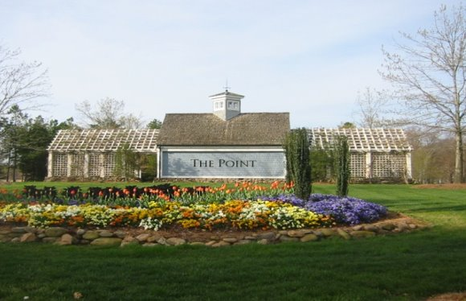
www.thepointatlkn.com
Landscape Committee
2024 Upcoming Project Priorities​
Expand focus on early identification, restoration and resolution of landscaping issue including disease and damage to preserve trees and shrubs and minimize replacement costs
24
© The Point Owners Association, Inc., 2024

Slide 25
www.thepointatlkn.com
3 Year BSR Berm Refresh Project
Why Spend Money to Update Brawley School Road Landscape​?
BSR corridor is the gateway to our the community​
We are getting close to 30 years old and updating is needed​
Trees have matured and are growing into each other, thinning is necessary​
Disease, emerald ash borer, has infected some of our trees ​
Some plant material, especially compacta holly, have outlived their lifespan​
There are gaps in the plantings where material has died out over the years​
More groundcover is being introduced to help save $ over time​
We have to protect our investment and our property values
© The Point Owners Association, Inc., 2024

Slide 26
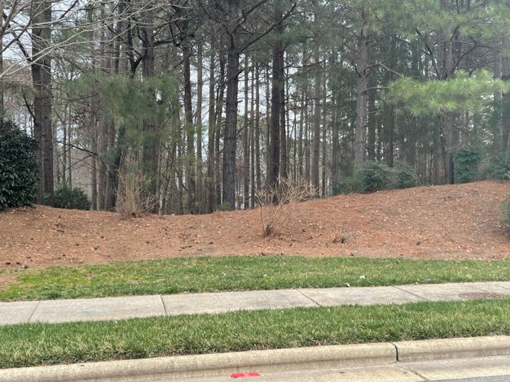
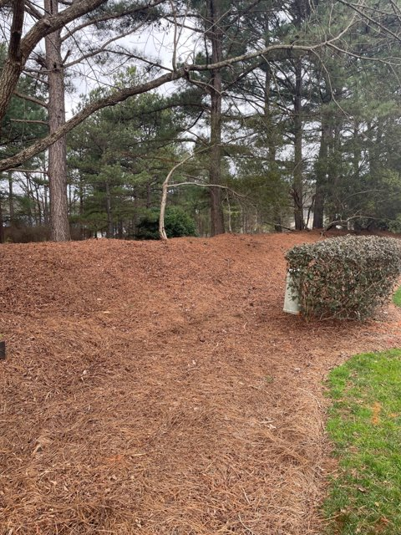
www.thepointatlkn.com
Before: Examples of missing plant materials
26
© The Point Owners Association, Inc., 2024

Slide 27
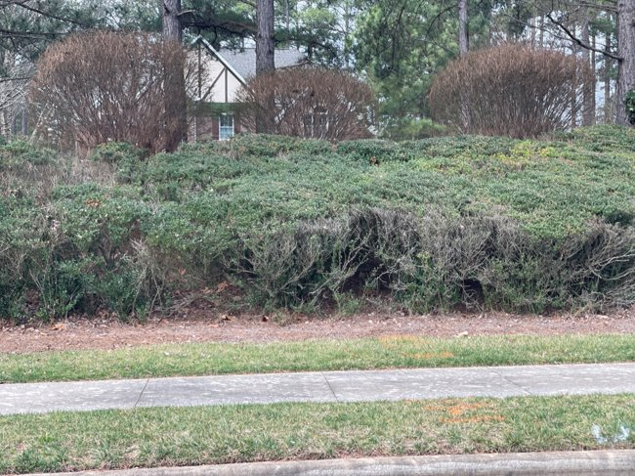
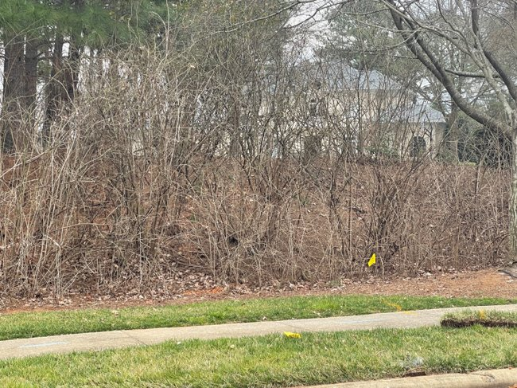
www.thepointatlkn.com
Renovation Challenges:​
Overgrown areas, aged out plant material
© The Point Owners Association, Inc., 2024
27

Slide 28
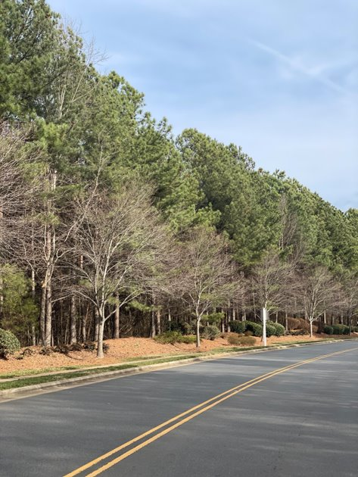
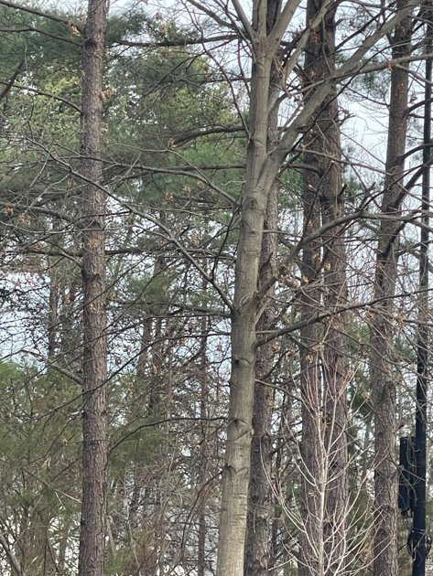
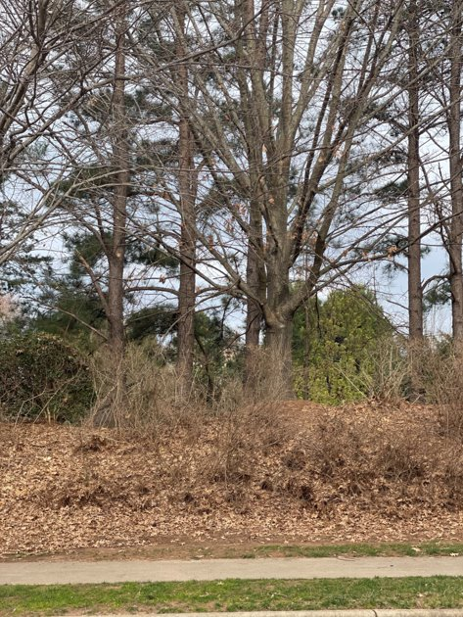
www.thepointatlkn.com
Competition Among Trees:​
Large maturing tree are being shaded out
28
© The Point Owners Association, Inc., 2024

Slide 29
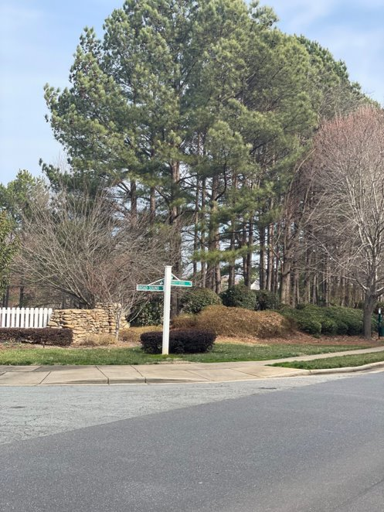
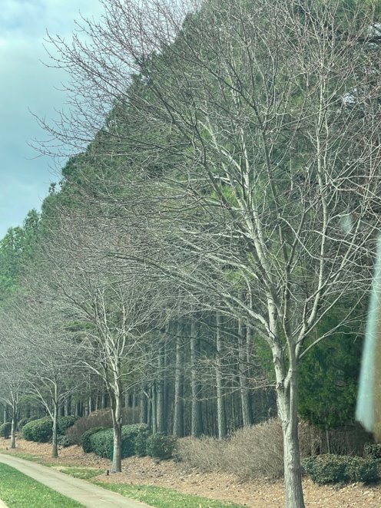
www.thepointatlkn.com
Pines Growing into Each Other:
Need thinning
© The Point Owners Association, Inc., 2024
29

Slide 30
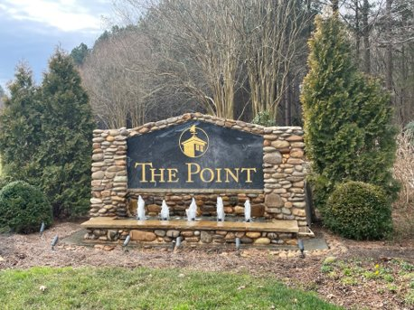
www.thepointatlkn.com
BSR Berm Refresh Project - Our Approach
Divided BSR into 10 sections, each about 0.3 - 0.4 miles
#1: Chuckwood – Bay Harbor / Great Point​
#2: Bay Harbor – 1728 Private Drive roadway​
#3: 1728 PD - Quaker​
#4: Quaker - Center Circle Round-about​
#5: Center Circle - 2006 Private Drive roadway​
#6: 2006 PD – Yacht Road​
#7: Yacht Road – New Haven​
#8: New Haven – Broadsound​
# 9: Broadsound – Grey Friers​
#10: Grey Friers - Hopkinton
© The Point Owners Association, Inc., 2024
30

Slide 31
www.thepointatlkn.com
BSR Berm Project 3 Year Timeline
Year 1: 2023
Trees removed berms 3,4,5,6.
Landscape contractor signed and plants ordered.
Planting on berms 3,4,5 to start Jan 2024
Cost of $194,000 on budget of $195,000
Year 2: 2024
Tree removals 1,7,8.
Further plantings on 1,6,7,8 to start early 2024 with end of year completion date.
Budget of $195,000. Anticipated to be on budget.
Year 3: 2025
Jan 2025- March 2025, tree removal and replanting of berms 2,9,10
Budget of $195,000. Anticipated to be on budget.
Depending on external factors, plantings may finish end of year.
31
© The Point Owners Association, Inc., 2024

Slide 32
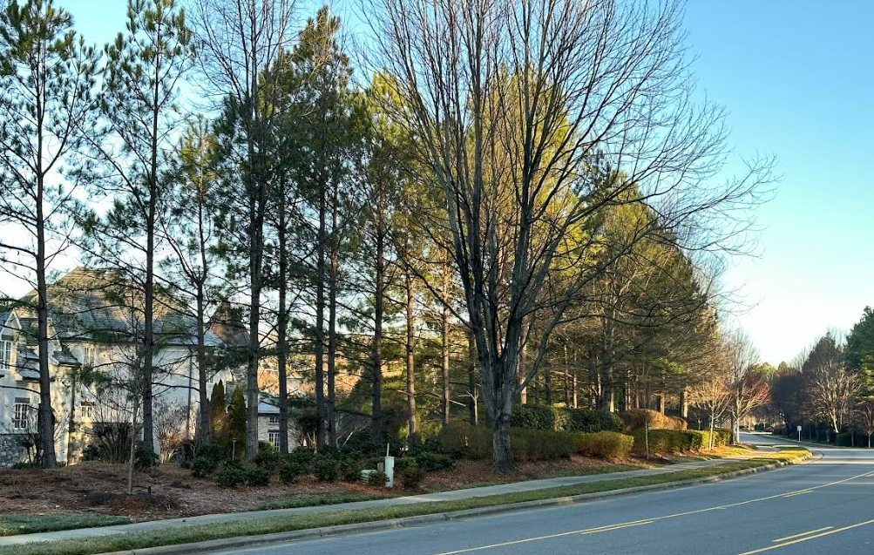
After: Pines thinned and overhanging branches removed
www.thepointatlkn.com
© The Point Owners Association, Inc., 2024

Slide 33
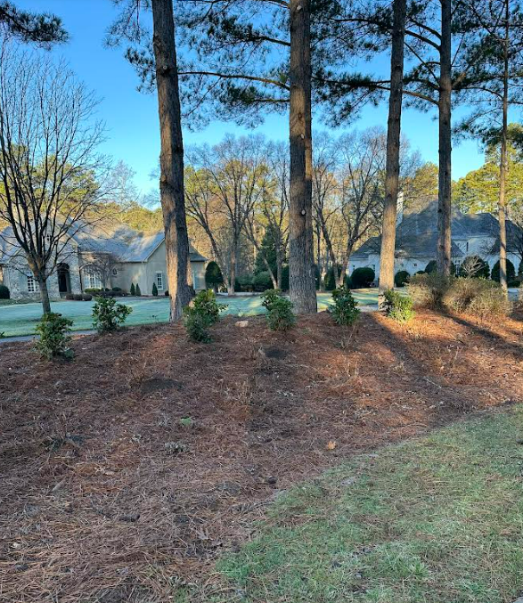
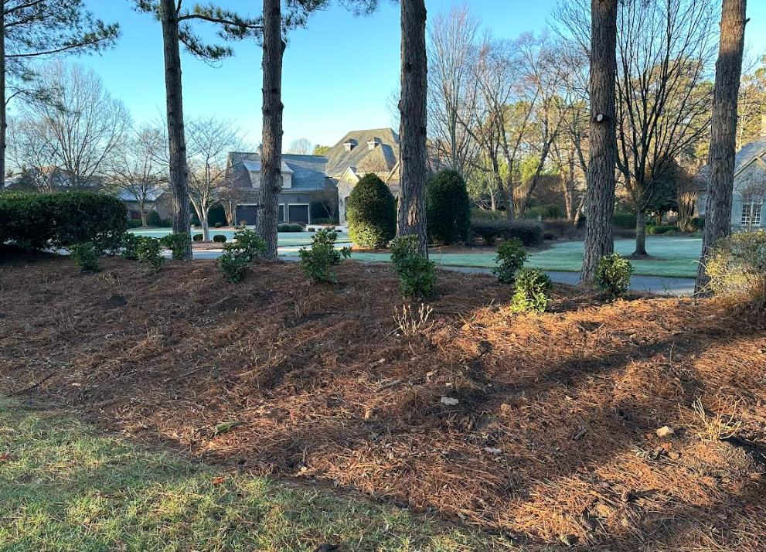
After: Lots of pine thinning and limbing up
And new plantings on berm
www.thepointatlkn.com
© The Point Owners Association, Inc., 2024

Slide 34
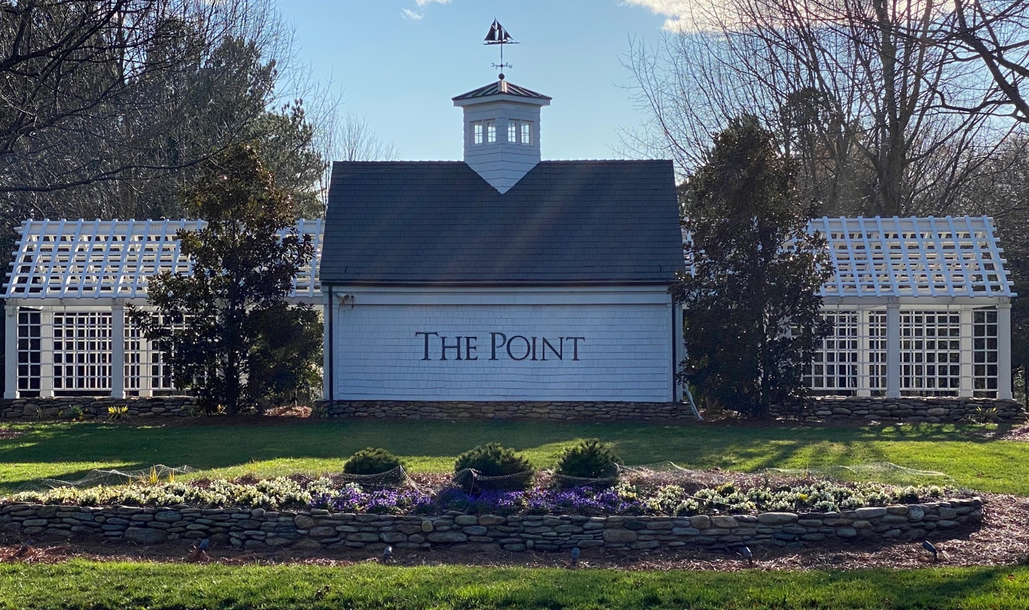
www.thepointatlkn.com
Infrastructure Committee
2023 Accomplishments
Leveled and replaced multiple sidewalks and drains
Replaced and repaired numerous street and village signs
Repaired common area swing sets and village fences
2024 Projects/Improvements
Upgrade/enhance the Village Trail
Continue to level and replace additional sidewalks
Continue to replace and repair street and village signs
34
© The Point Owners Association, Inc., 2024

Slide 35
Architectural Committee
Purpose:
The CCR’s and Architectural Guidelines have been developed to maintain the overall design philosophy of The Point … to blend structures, lake, golf course and landscaping into a pleasing residential community. The ACC is responsible for their application and to insure the community objectives are applied equally to all residents.
Key Considerations:
Community Objectives
CCR’s & Guidelines
Tree Canopy & Preservation
Setbacks & Sightlines
Governance:
Golf Course & Lake restrictions
Duke Energy & NCDEQ restrictions
Iredell County regulation & restrictions
Environment & Safety
35
© The Point Owners Association, Inc., 2024

Slide 36
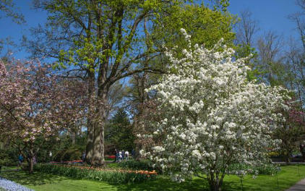
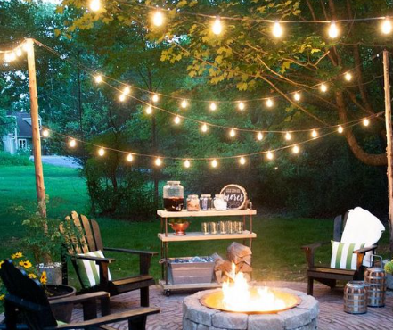
Architectural Committee
2023 Activity:
215+ Projects
60+ Consults
≥ 50% Involve Trees
19 Pools
Updates To Guidelines:
Irrigation Wells … CLC will consult:
Location and Restrictions
Artificial Turf approved with restrictions:
Location, Setbacks, Restricted Areas
Environmental Considerations
Preservation / Restoration of Tree Canopy
String Lighting = Prohibited
Points
of
Emphasis
© The Point Owners Association, Inc., 2024
36

Slide 37
www.thepointatlkn.com
TNGC Covenant Annual Report
MEMBERSHIP CATEGORY : 2020 2022 2023 2024:
Full Golf $25k/$770 $50k/$870 $50k/$960 $75k/$1060
Junior Golf $15k/$385 $25k/$435 $25k/$480 $50k/$530
Sports $9.5k/$450 $17k/$560 $17k/$615 $17k/$675
Health & Fitness $7.5k/$355 $7.5k/$465 $7.5k/$510 $7.5k/$560
Social $4k/$245 $4k/$267 $4k/$280 $4k/$294
MEMBERSHIP % INCREASES (2020 to 2024):
Full Golf 27.4%
Junior Golf 27.4%
Sports 33.3%
Health & Fitness 36.6%
Social 16.6% (less than 5% year required)
FULL GOLF MEMBERSHIPS: 479 out of 500 (plus 76 Sports Limited) - REQUIRED
© The Point Owners Association, Inc., 2024
37

Slide 38
www.thepointatlkn.com
Community Pier Committee (CPC)
Purpose: Establish standards to keep all community piers within The Point in a well-maintained, safe, clean and attractive condition
COMMITTEE MEMBERS:
Joe Klaja (Chairman)
Rod Baldwin (BOD Liason)
Mike Ackerman
Will Baeza
Jon Packman
Chuck Taylor (SME Advisor)
KEY PLAYERS:
Duke Energy Master Lease
Iredell County
NC Wildlife Resources Commission
POA CCRs/Guidelines
Pier Associations
Boat Slip Lessees
38
© The Point Owners Association, Inc., 2024

Slide 39
www.thepointatlkn.com
Community Pier Committee (CPC)
FOCUS AREAS:
Electrical Standards (completed)
Structural Standards (in process)
Governance Standards (kicked off)
Insurance Standards (TBD)
DELIVERABLES:
Baseline compliance metrics as defined by marine industry standards
Schedule and best practices/guidelines for maintaining compliance
Effective governance model
Compehensive cost effective liability protections
39
© The Point Owners Association, Inc., 2024

Slide 40
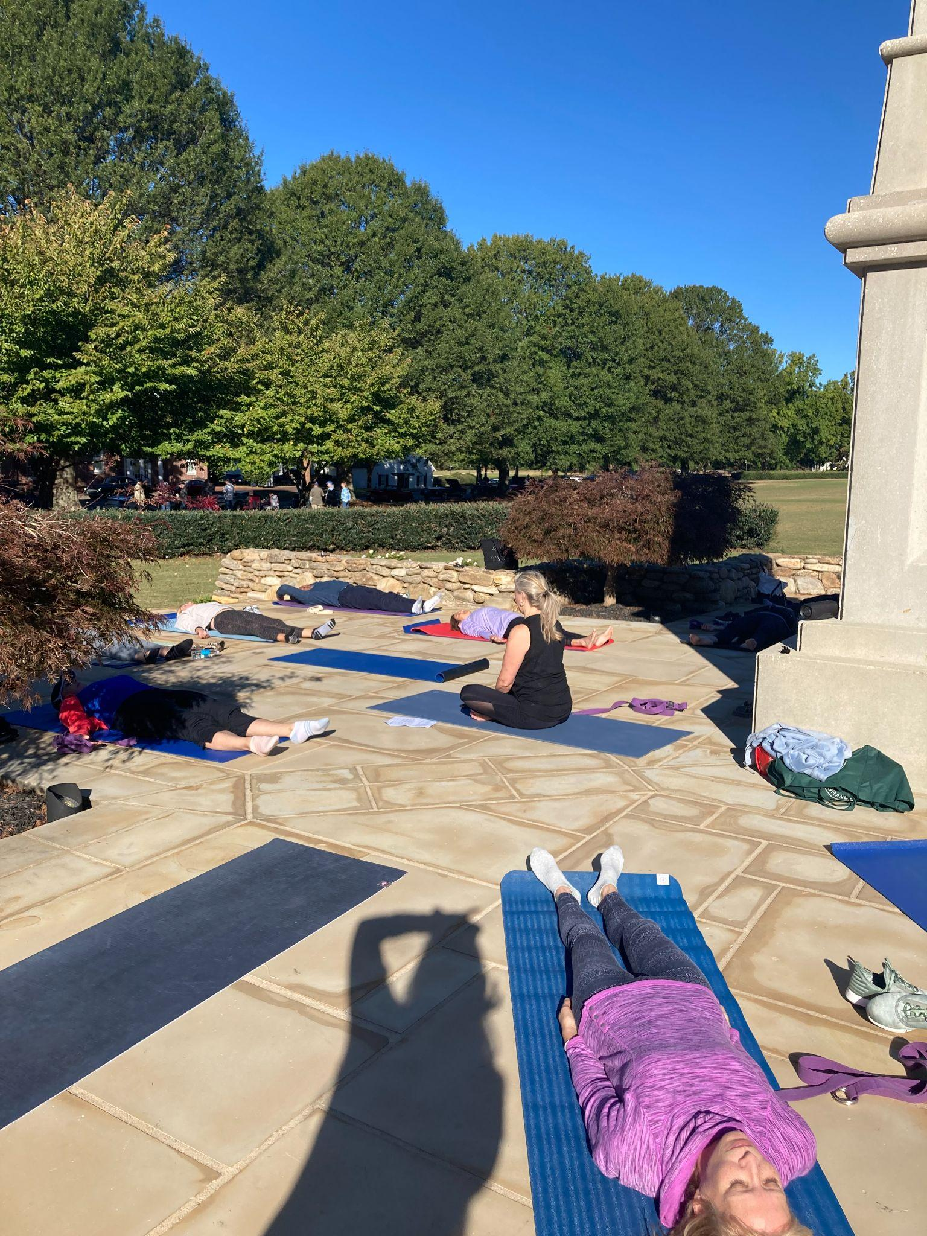
www.thepointatlkn.com
Communications Committee
2023 Accomplishments:
Regular communications via email and The Stroll magazine
Village Ambassadors personally welcomed 52 families to our neighborhood. Special recognition to the 20+ volunteers dedicating their time to this initiative
Annual New Resident Welcome Event
Co-hosted alongside TNGC
Welcome new residents and club members
Opportunity to meet POA and Club leadership
Meet other new residents
Events on the Green (new in 2023)
Held first event- Yogo on the Green
Committee planning more for 2024
40
© The Point Owners Association, Inc., 2024

Slide 41
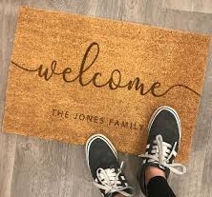
www.thepointatlkn.com
Communications Committee
2024 Projects:
Continue regular communications via email and The Stroll magazine
Continue to welcome new residents via Village Ambassadors and hosting the Annual New Resident Welcome Event
Expand Events on the Green
Seeking potential sponsors
Update The Point website
Seeking volunteer web designer
41
© The Point Owners Association, Inc., 2024

Slide 42
www.thepointatlkn.com
Contact Information
Please reach out to Hawthorne Management to ensure they have a correct email address on file for you and your spouse.
42
© The Point Owners Association, Inc., 2024

Slide 43
www.thepointatlkn.com
Save the Date: Candidate Forum
Volunteers from our community have organized a Candidate Forum with 6 of the 7 candidates running for Iredell County Commissioner
It will take place March 1, 2024 from 5:30 - 7:30 pm in the Lakefront Ballroom
43
© The Point Owners Association, Inc., 2024

Slide 44
www.thepointatlkn.com
Carolina Water Service Update
2023 Activity:
Homeowners voted to amend CCRs to allow private irrigation wells on non-waterfront lots
Private Irrigation Well Guidelines created and published
Formation of Interface Committee in partnership with The Farms and The Harbour to work with Carolina Water Services on various matters:
customer relationship matters
well closing activities
plans for lots with closed wells
44
© The Point Owners Association, Inc., 2024

Slide 45
www.thepointatlkn.com
CWS Matters Current Status
Customer Relations:
Personal prompt added to 1-800 number for trouble-shooting
Efforts to develop Water Conservation Seminar were discontinued
Closed Wells:
CWS agreed to obtain third party contractor bids to complete “abandoment,” within NC requirements, and to inform POA of any abandonment activities on relevant lots
To date, CWS has not provided any such information to The POA, although activities on some (or all?) closed well lots have been taken place and CWS personnel have indicated informally that “abandonment” would be cost-prohibitive
Lots with Closed Wells:
Community System Water Agreement requires CWS to transfer ownershi of lots no longer used for the water system to Crescent successor, at no cost, if requested (rather than sell to a third party)
In late 2023, Crescent successor expressed interest in acquiring closed well lots for development as part of The POA
As of early 2024, CW had not responded to Crescent successor inquiries
CWS intends to install communication towers on two well lots in The POA
45
© The Point Owners Association, Inc., 2024

Slide 46
www.thepointatlkn.com
Questions?
© The Point Owners Association, Inc., 2024
46

Slide 47
Questions? More Information?
WEBSITE: THEPOINTATLKN.COM
E-MAIL: admin@hawthornemgmt.com
PH. 704-377-0114
47
© The Point Owners Association, Inc., 2024

Slide 48
www.thepointatlkn.com
48
© The Point Owners Association, Inc., 2024

